Slide 1
DEEP NEURAL NETWORKS

Slide 2
Artificial Neural Networks
The effective weight of the element is the sum of the weights multiplied by their respective input values
v1 * w1 + v2 * w2 + v3 * w3
Each element has a numeric threshold value
If the effective weight exceeds the threshold, the unit produces an output value of 1
If it does not exceed the threshold, it produces an output value of 0

Slide 3
A Neuron (= a perceptron)
-
t
x₀
w₀
x₁
w₁
∑
f
output y
x_{n}
w_{n}
Input
vector x
weight
vector w
weighted
sum
Activation
function
The n-dimensional input vector x is mapped into variable y by means of the scalar product and a nonlinear function mapping
March 5, 2022
Data Mining: Concepts and Techniques
3
Notes:
3

Slide 4
Perceptron
Basic unit in a neural network
Linear separator
Parts
N inputs, x₁ ... x_{n}
Weights for each input, w₁ ... w_{n}
A bias input x₀ (constant) and associated weight w₀
Weighted sum of inputs, y = w₀x₀ + w₁x₁ + ... + w_{n}x_{n}
A threshold function or activation function,
i.e 1 if y > t, -1 if y <= t

Slide 5
Artificial Neural Networks (ANN)
Model is an assembly of inter-connected nodes and weighted links
Output node sums up each of its input value according to the weights of its links
Compare output node against some threshold t
Perceptron Model
or

Slide 6
Types of connectivity
output units
Feedforward networks
These compute a series of transformations
Typically, the first layer is the input and the last layer is the output.
Recurrent networks
These have directed cycles in their connection graph. They can have complicated dynamics.
More biologically realistic.
hidden units
input units

Slide 7
Different Network Topologies
Single layer feed-forward networks
Input layer projecting into the output layer
Single layer
network
Input Output
layer layer

Slide 8
Different Network Topologies
Multi-layer feed-forward networks
One or more hidden layers. Input projects only from previous layers onto a layer.
2-layer or
1-hidden layer
fully connected
network
Input Hidden Output
layer layer layer

Slide 9
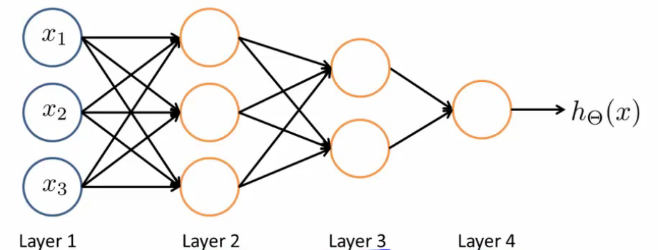
Different Network Topologies
Multi-layer feed-forward networks
Input Hidden Output
layer layers layer

Slide 10
Different Network Topologies
Recurrent networks
A network with feedback, where some of its inputs are connected to some of its outputs (discrete time).
Recurrent
network
Input Output
layer layer

Slide 11
Neural Network Model
Inputs
Output
Age
34
.6
.4
.2
Σ
0.6
.1
.5
Gender
2
Σ
.3
.2
.8
.7
Σ
“Probability of beingAlive”
Stage
4
.2
Dependent variable
Prediction
Independent variables
Weights
HiddenLayer
Weights

Slide 12
Algorithm for learning ANN
Initialize the weights (w₀, w₁, …, w_{k})
Adjust the weights in such a way that the output of ANN is consistent with class labels of training examples
Error function:
Find the weights w_{i}’s that minimize the above error function
e.g., gradient descent, backpropagation algorithm

Slide 13
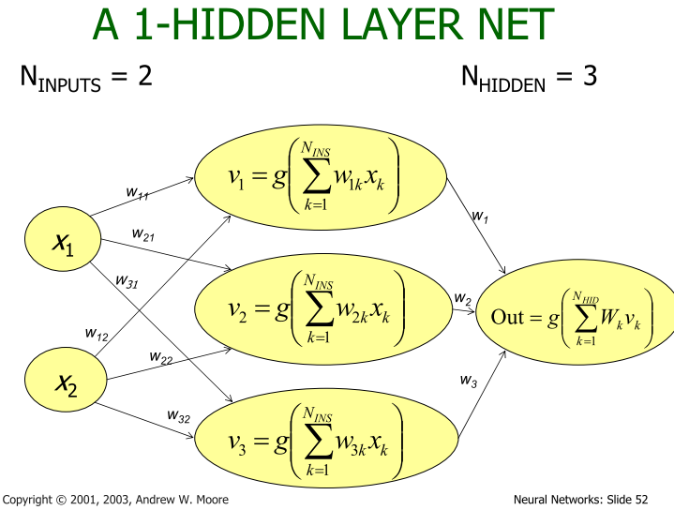

Slide 14
Neural Network
Decision Functions
y
Output
a₁
a₂
…
a_{D}
Hidden Layer
x₁
x₂
x₃
…
x_{M}
Input
Notes:
TODO: Include the math on the right.
TODO: Show the parameters.

Slide 15
Neural Network
Decision Functions
Output
y
Hidden Layer
z₁
z₂
…
z_{D}
Input
x₁
x₂
x₃
…
x_{M}

Slide 16
Building a Neural Net
y
Output
x₁
x₂
…
x_{M}
Features
Notes:
This is regular perceptron

Slide 17
Building a Neural Net
y
Output
a₁
a₂
…
a_{D}
Hidden Layer
D = M
1
1
1
x₁
x₂
…
x_{M}
Input
Notes:
What if we connect all the X to all the Z?

Slide 18
Building a Neural Net
y
Output
a₁
a₂
…
a_{D}
Hidden Layer
D = M
x₁
x₂
…
x_{M}
Input
Notes:
What if we connect all the X to all the Z?

Slide 19
Building a Neural Net
y
Output
a₁
a₂
…
a_{D}
Hidden Layer
D = M
x₁
x₂
…
x_{M}
Input
Notes:
What if we connect all the X to all the Z?

Slide 20
Building a Neural Net
y
Output
a₁
a₂
…
a_{D}
Hidden Layer
D < M
x₁
x₂
x₃
…
x_{M}
Input
Notes:
What if we connect all the X to all the Z?

Slide 21
Decision Boundary
0 hidden layers: linear classifier
Hyperplanes
Example from to Eric Postma via Jason Eisner

Slide 22
Decision Boundary
1 hidden layer
Boundary of convex region (open or closed)
Example from to Eric Postma via Jason Eisner
Notes:
We saw with XOR

Slide 23
Decision Boundary
2 hidden layers
Combinations of convex regions
Example from to Eric Postma via Jason Eisner

Slide 24
Multi-Class Output
Decision Functions
y₁
…
y_{K}
Output
a₁
a₂
…
a_{D}
Hidden Layer
x₁
x₂
x₃
…
x_{M}
Input
Notes:
Why called feed forward?

Slide 25
Deeper Networks
Decision Functions
Next lecture:
Output
y
Hidden Layer 1
a₁
a₂
…
a_{D}
Input
x₁
x₂
x₃
…
x_{M}

Slide 26
Deeper Networks
Decision Functions
Next lecture:
Output
y
Hidden Layer 2
b₁
b₂
…
b_{E}
Hidden Layer 1
a₁
a₂
…
a_{D}
Input
x₁
x₂
x₃
…
x_{M}

Slide 27
Deeper Networks
Decision Functions
Next lecture: Making the neural networks deeper
Output
y
Hidden Layer 3
c₁
c₂
…
c_{F}
Hidden Layer 2
b₁
b₂
…
b_{E}
Hidden Layer 1
a₁
a₂
…
a_{D}
Input
x₁
x₂
x₃
…
x_{M}

